Slide 1

DRIVING SCHOOL MANAGEMENT SYSTEM
PROJECT MEMBERS :-
2587390 - Biswaranjan Prusty.
2587247 - Chandan kumar Sahu.
2587638 - Chetan Kailas Sathe.
2587245 - Chitteti Naga Sri Surya Vara Prasad.
2587335 - Kaaza S Abhignah.
2586998 - Dorepalli Sai Sumanth.
2587545 - G Praveena.
2587398 - Guduri Gopala Krishna.

Slide 2

Agenda:
Abstract
Introduction
Tools & Technologies
ER Diagram
Modules
Output
Conclusion

Slide 3
ABSTRACT
The purpose of Driving School Management System is to automate the existing manual system by the help of computerized equipment's and full-fledged computer software, fulfilling their requirements, so that record keeping more productive and recover information quickly.

Slide 4
INTRODUCTION
This Advanced Motor Driving School Management system can reduce the efforts of human power and wealth very much and ensure driving-training school’s information resource to be utilized effectively.
The motor driving trainers must handle several students at a time. This will provide drawback in terms of communicating with students for his or her driving category schedule or test. It is a web-based application for maintaining records of car and bike(2-wheeler and 4-wheeler) training school.

Slide 5





TECHNOLOGY USED
Front-End :Angular
Server-side: Spring Boot
Back-end: MYSQL, Hibernate
Server: Tomcat

Slide 6
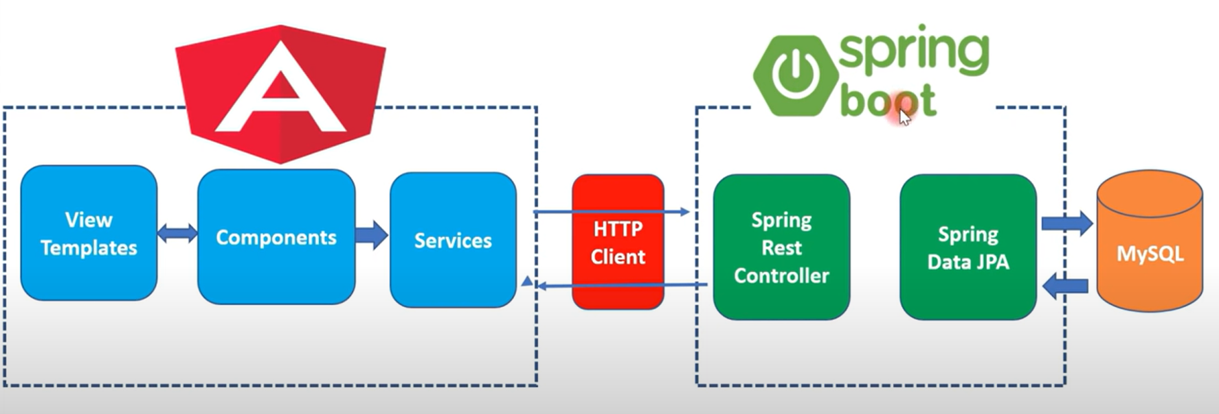
Angular + Spring boot Crud Full stack

Slide 7
Angular:
Angular is a JavaScript framework which makes you able to create reactive Single Page Applications (SPAs).
Features of Angular
Two-Way Data Binding
Powerful Routing Support

Slide 8
Spring Boot:
Spring Boot is an open source Java-based framework used to create a Micro Service.
Advantages:
Easy to understand and develop spring applications
Increases productivity
It provides a flexible way to configure Java Beans, XML configurations, and Database Transactions.

Slide 9
MySQL:
MySQL, the most popular Open Source SQL database management system, is developed, distributed,and supported by Oracle Corporation.
MySQL is a database management system.
MySQL databases are relational.

Slide 10
Hibernate:
Hibernate is a high-performance Object/Relational persistence and query service, which is licensed under the open source GNU Lesser General Public License (LGPL) and is free to download.
Hibernate not only takes care of the mapping from Java classes to database tables, but also provides data query and retrieval facilities.

Slide 11
ER DIAGRAM
Student
Attendance
id : int
name : varchar(255)
admission_date : varchar(255)
training_type : varchar(255)
location : varchar(255)
age : int
username : varchar(255)
password : varchar(255)
aid : int
attendance : varchar(255)
date : varchar(255)
student_id : int
id : int (Primary key)
name : varchar(255)
password : varchar(255)
Admin
Many-to-one
Many-to-one
vid : int
brand : varchar(255)
model : varchar(255)
type :varchar(255)
tid : int
location : varchar(255)
name : varchar(255)
vid : int
sid : int
time : varchar(255)
student_id : int
trainer_tid : int
Vehicle
Trainer
Schedule
One –to-one
Many-to-one

Slide 12
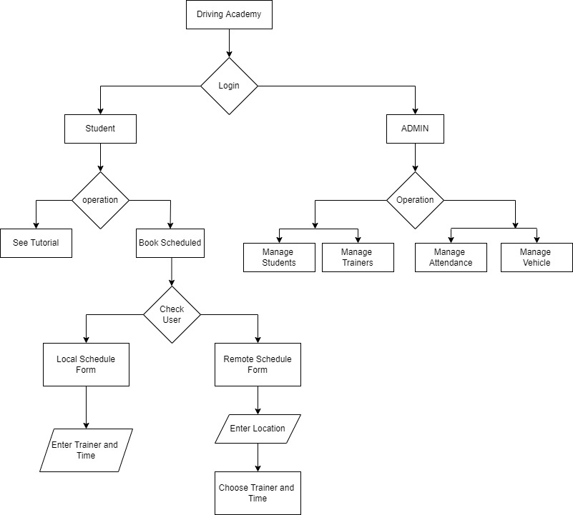

Slide 13
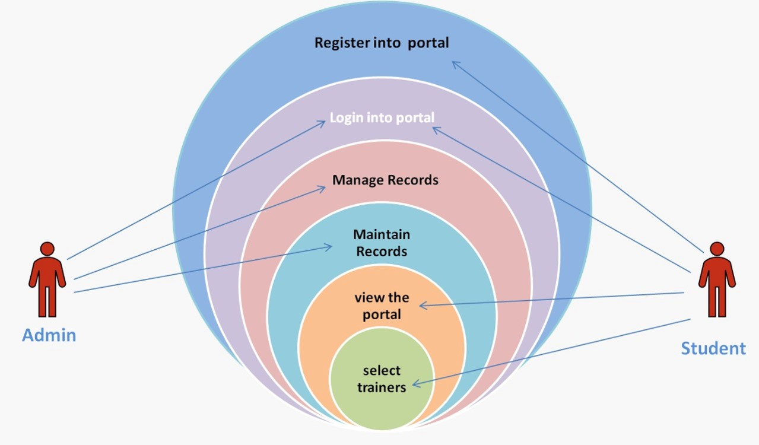

Slide 14
Annotations:
Request Mapping
Auto Wired
Post Mapping
Get Mapping
Delete Mapping
Put Mapping

Slide 15
Modules:
Admin and User login
Student Registration
Trainer
Attendance
Vehicle
Local Schedule
Tutorial and Remote Schedule

Slide 16
Admin and User Login:
create table admin( id int not null primary key auto_increment,
name varchar(255),
password varchar(255));

Slide 17
Flowchart:
Start
Admin Login
User Login
Student
Attendance
Tutorials
Training Schedule
Trainer
Vehicle

Slide 18
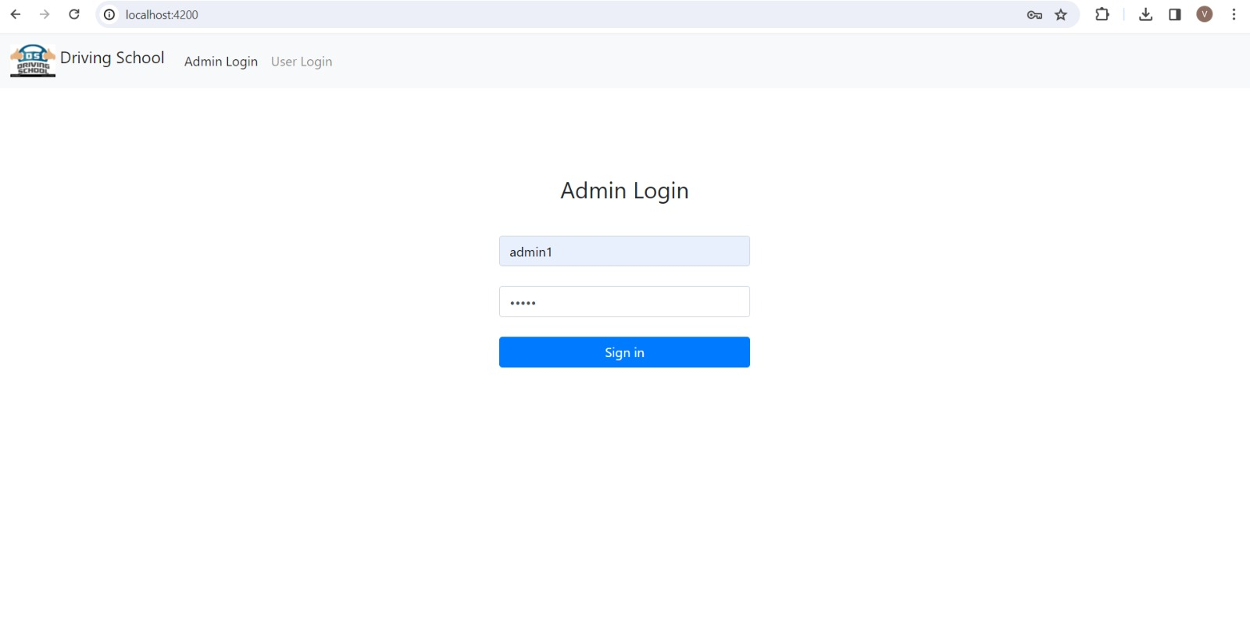
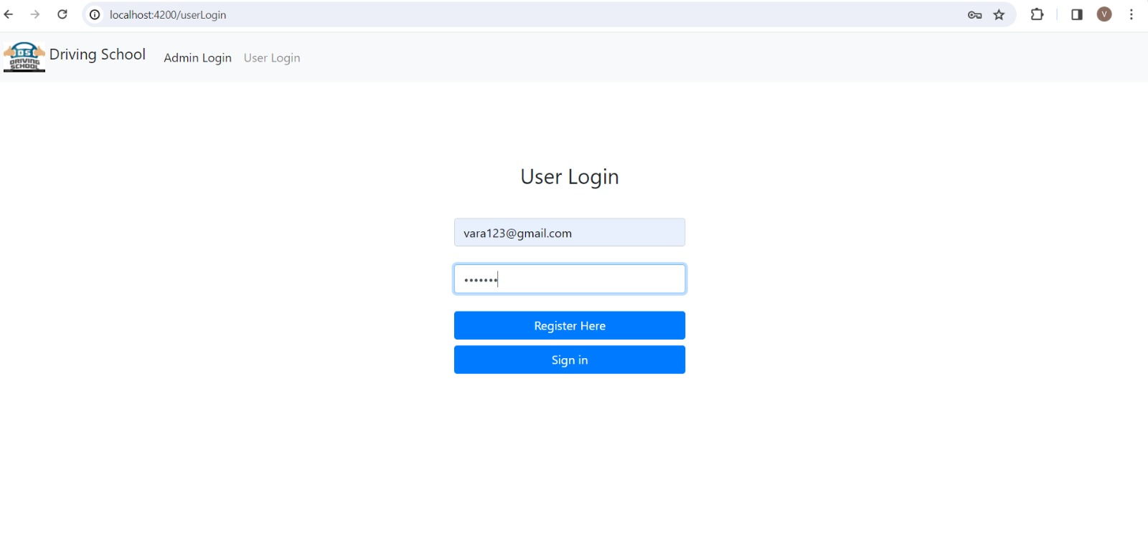
Output:
Admin Page-- User Page--

Slide 19
Admitting a New Student:
create table student( id int not null primary key auto_increment,
admission_date varchar(255),
age int not null,
location varchar(255),
name varchar(255),
password varchar(255),
training_type varchar(255),
username varchar(255));

Slide 20
Flowchart:
Start
Student Registration
ID
Name
Location
Username
Age
Admission Date
Trainer Type
Password
Actions

Slide 21
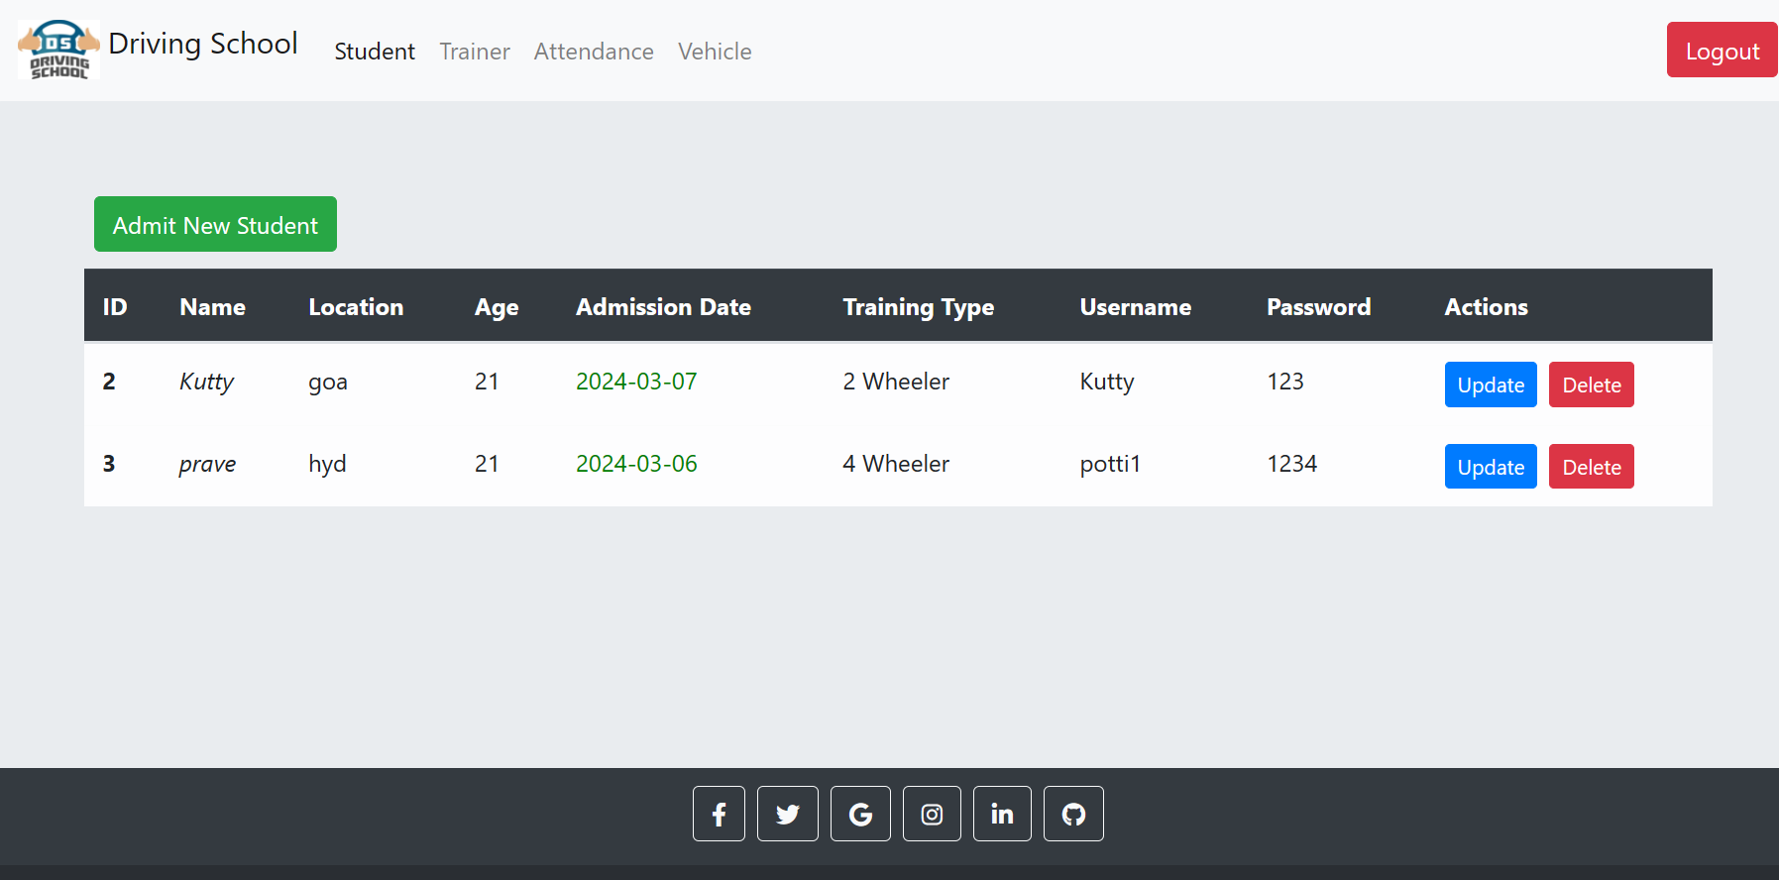
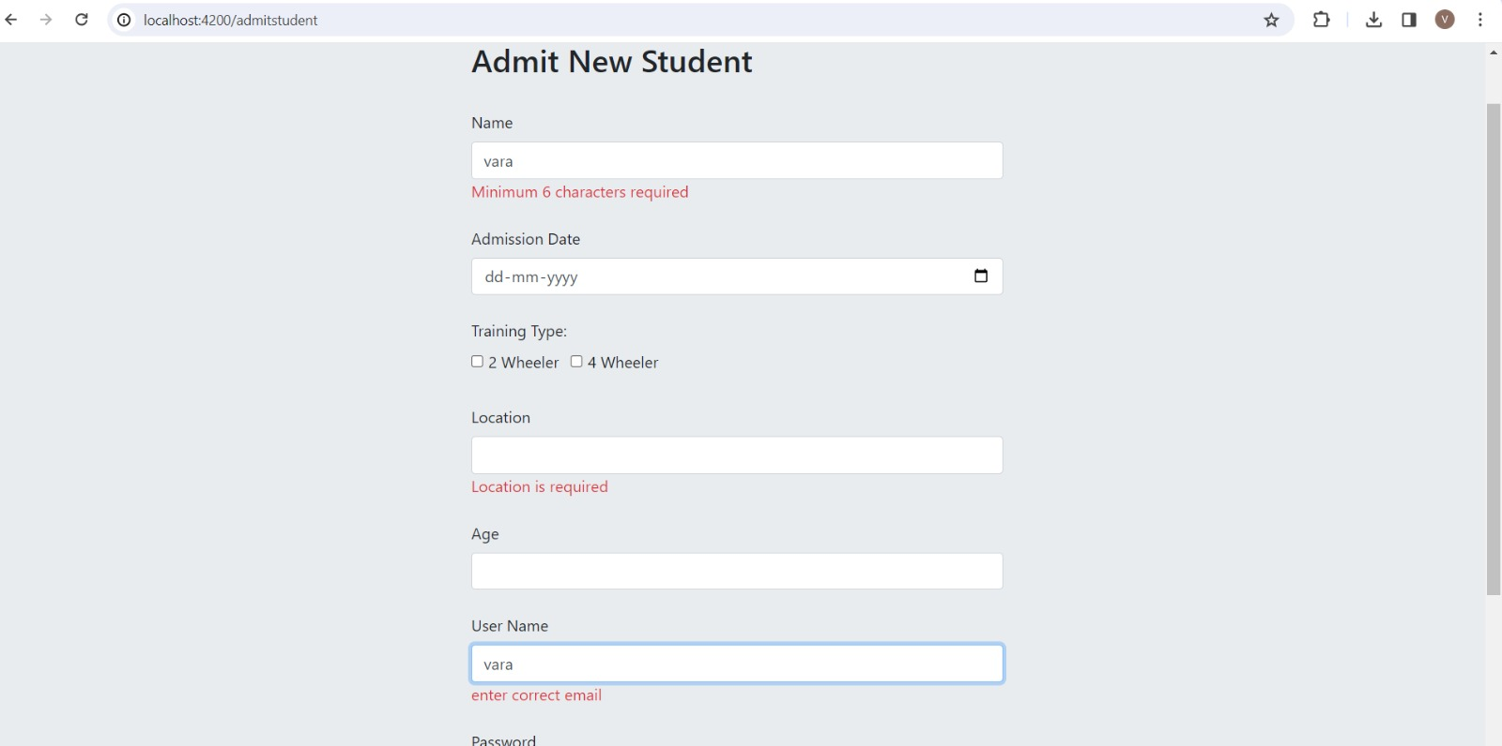
Output:

Slide 22
Trainer:
create table trainer( tid int not null primary key auto_increment,
location varchar(255),
name varchar(255),
vehicle_vid int,
foreign key (vehicle_vid) references vehicle(vid));

Slide 23
Flowchart:
Start
Trainer
Trainer ID
Trainer Name
Location
Vehicle ID
Actions

Slide 24
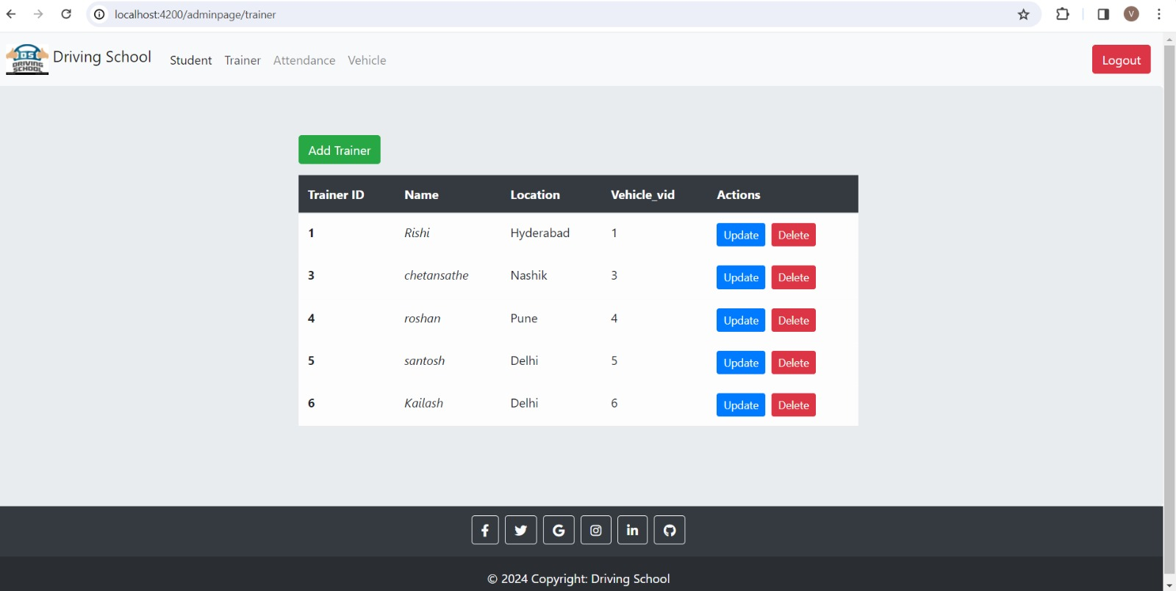
Output:

Slide 25
Attendance:
create table attendance( aid int not null primary key auto_increment,
attendence varchar(255),
date varchar(255),
student_id int,
foreign key (student_id) references student(id));

Slide 26
Flowchart:
Start
Attendance
Attendance ID
Student ID
Student Name
Attendance
Date

Slide 27
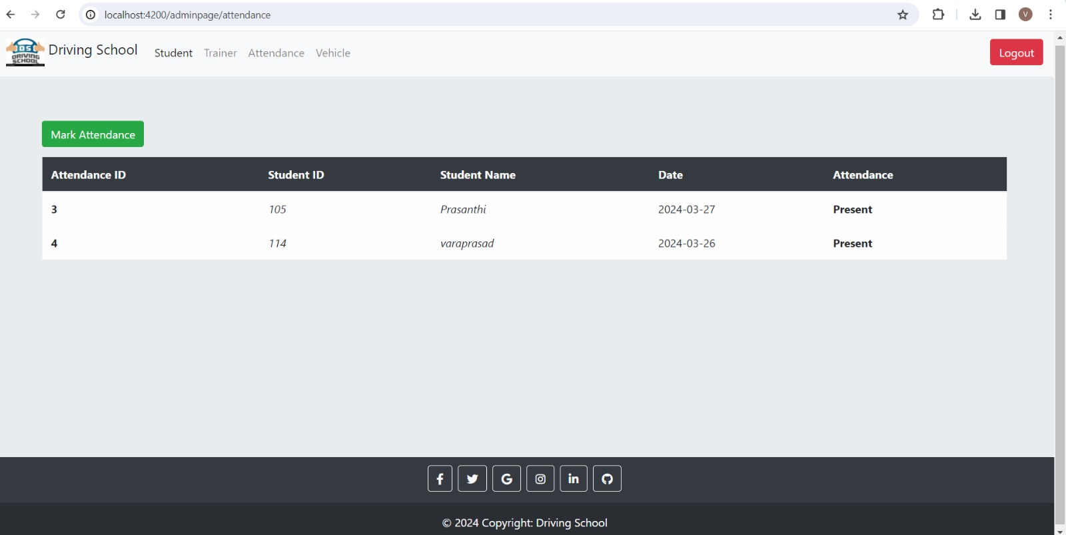
Outputs:

Slide 28
Vehicle:
create table vehicle( vid int not null primary key auto_increment,
brand varchar(255),
model varchar(255),
type varchar(255));

Slide 29
Flowchart:
Start
Vehicle
Vehicle ID
Brand
Model
Type
Actions

Slide 30
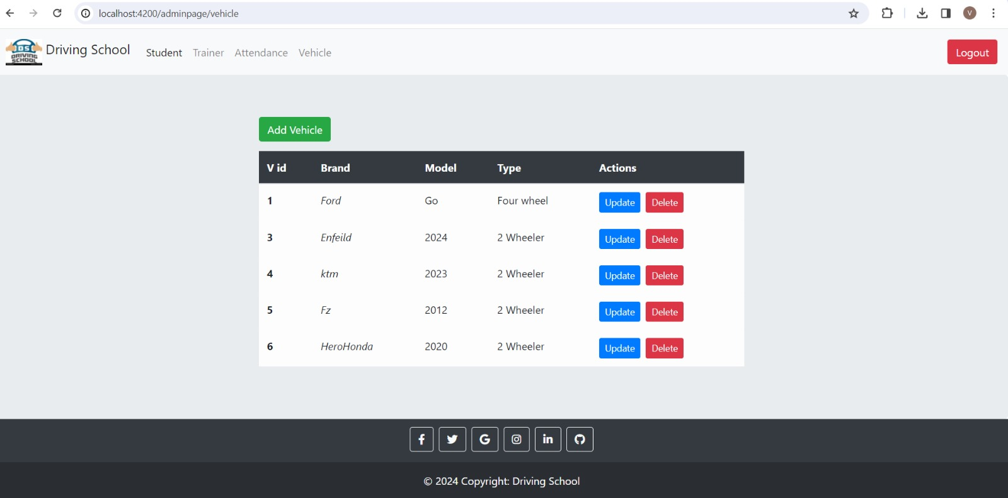
Output:

Slide 31
Local Schedule:
create table schedule( sid int not null primary key auto_increment,
time varchar(255),
student_id int,
trainer_id int,
date varchar(255),
foreign key (student_id) references student(id),
foreign key (trainer_id) references trainer(tid));

Slide 32
Flowchart:
Start
Local Schedule
Schedule ID
Student Name
Trainer Name
Date
Time
Actions

Slide 33
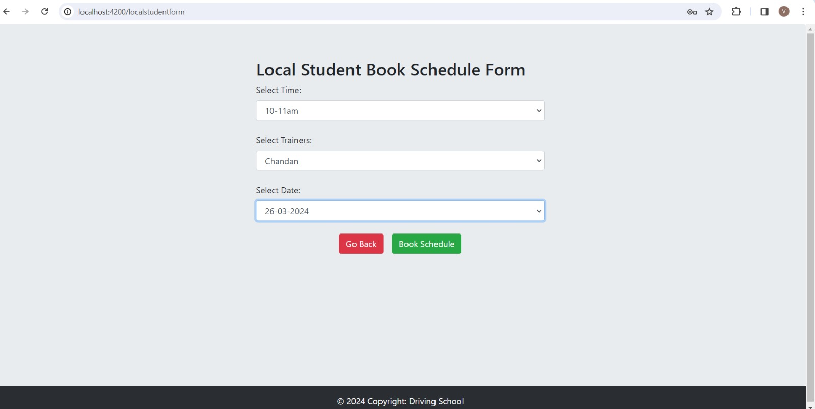
Output:

Slide 34
Remote Schedule:
create table schedule( sid int not null primary key auto_increment,
time varchar(255),
student_id int,
trainer_id int,
date varchar(255),
foreign key (student_id) references student(id),
foreign key (trainer_id) references trainer(tid));

Slide 35
Flowchart:
Start
Remote Schedule
Schedule ID
Student Name
Trainer Name
Date
Time
Actions

Slide 36
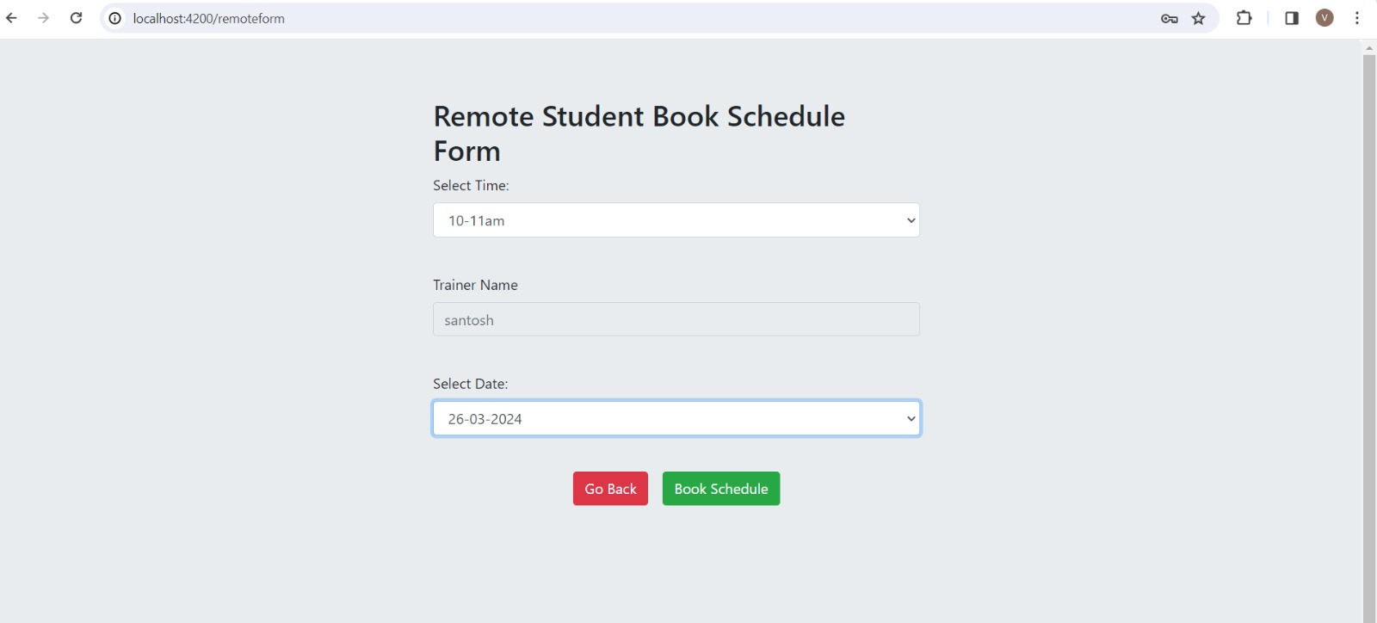
Output:

Slide 37
Junit Testing:
What is the use of JUnit testing?
JUnit testing is used to test the behaviour of methods inside classes we have written. We test a method for the expected results and sometimes exception-throwing cases—whether the method is able to handle the exceptions in the way we want.
Junit is used for which type of testing? JUnit is a Java unit testing framework that's one of the best test methods for regression testing. An open-source framework, it is used to write and run repeatable automated tests

Slide 38
Functional Testing:
What is postman ?
Postman is a computer application used for API testing. Postman sends an API request to the web server and receives the response,
Functional API Testing
API, or application program interface, is a system of communication methods that gives developers and non-developers access to programs, procedures, functions and services.
.

Slide 39
SCREENSHOTS OF OUTPUT

Slide 41
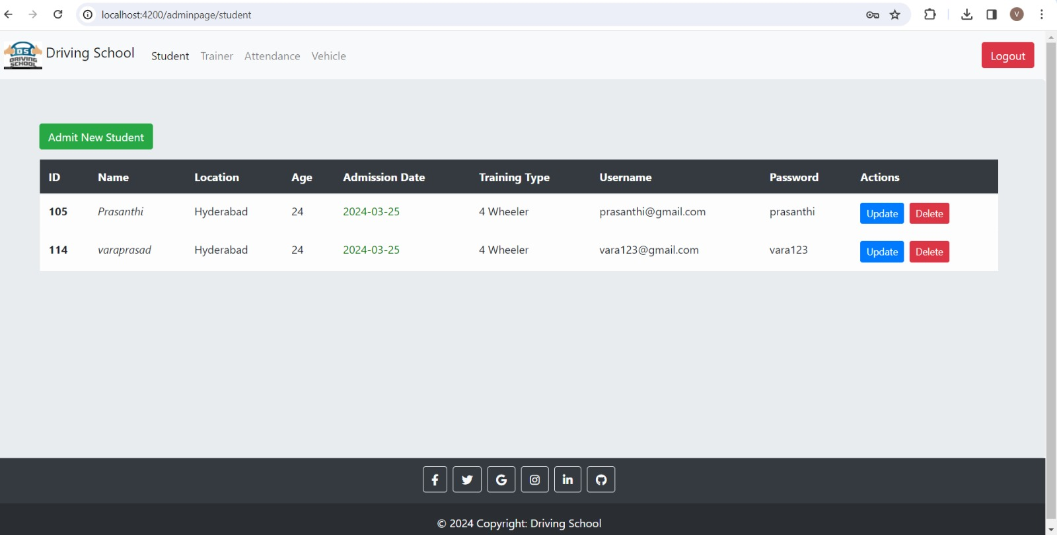

Slide 43
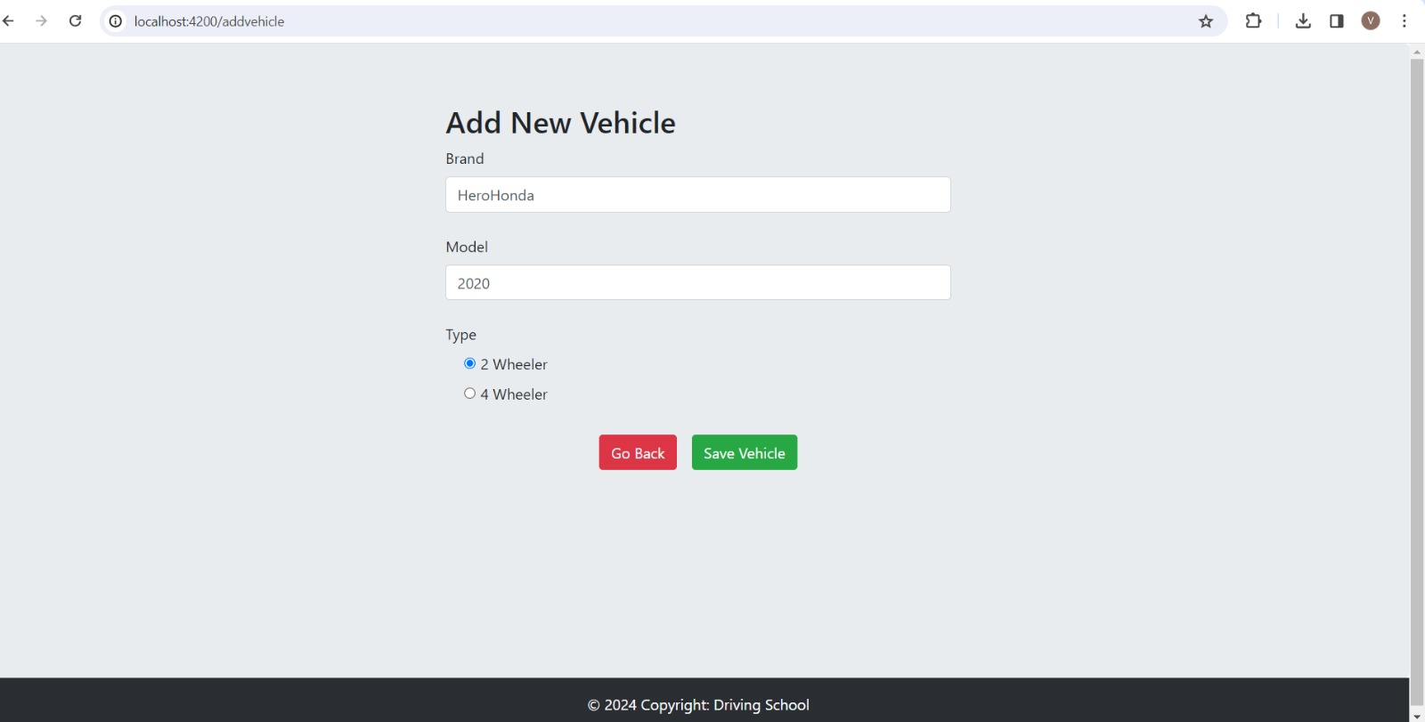

Slide 45
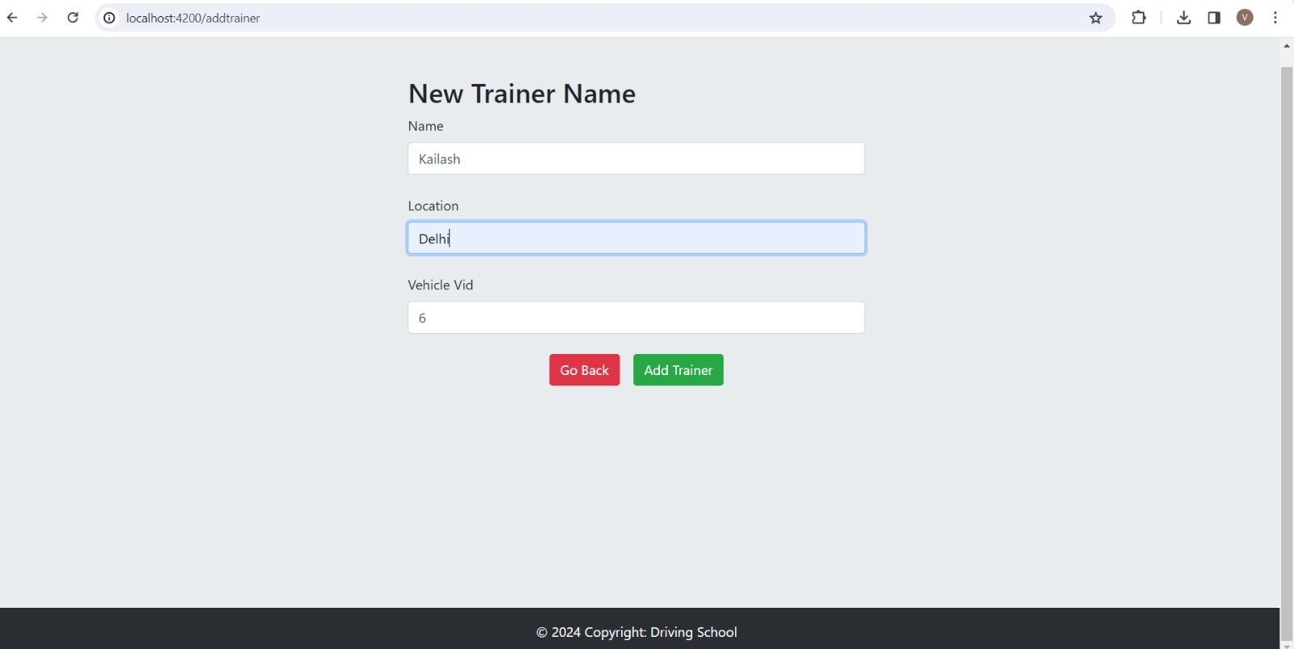

Slide 47
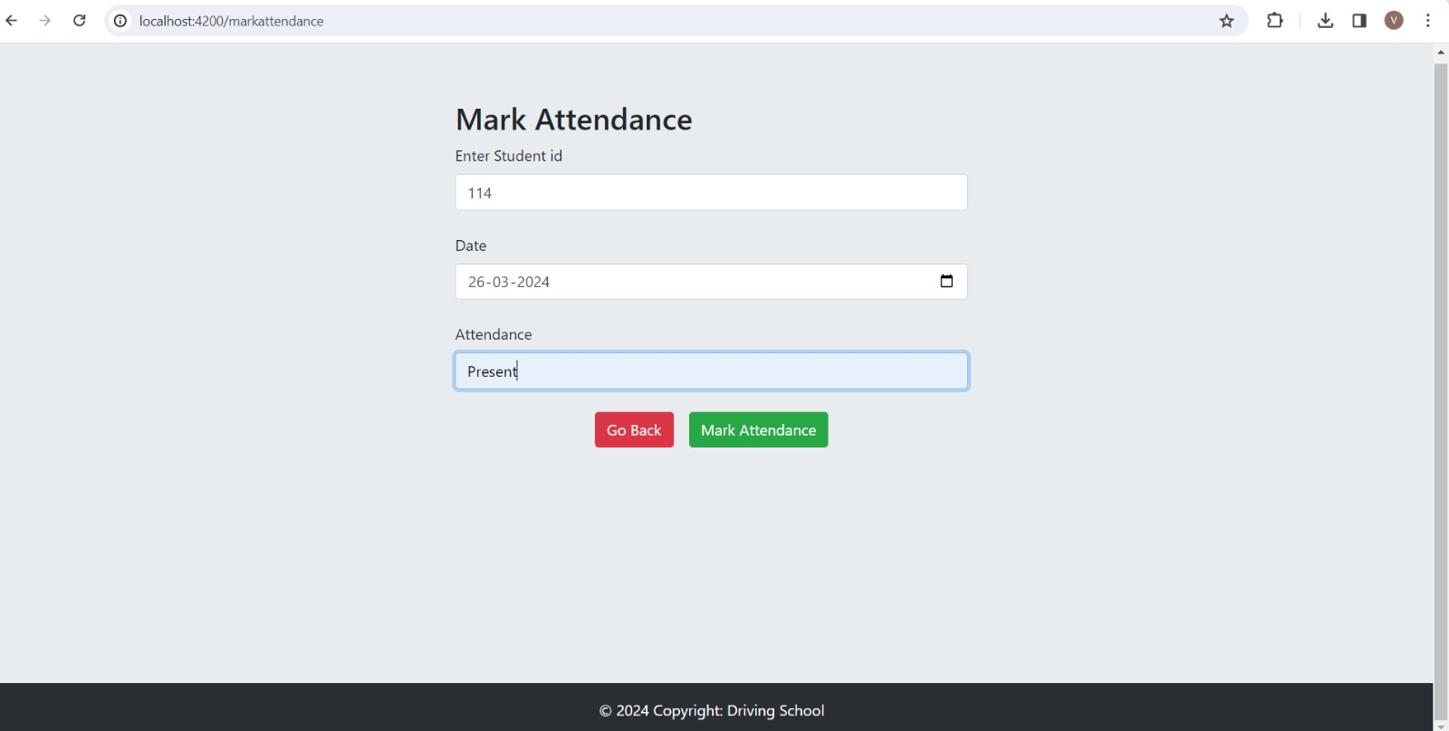

Slide 50
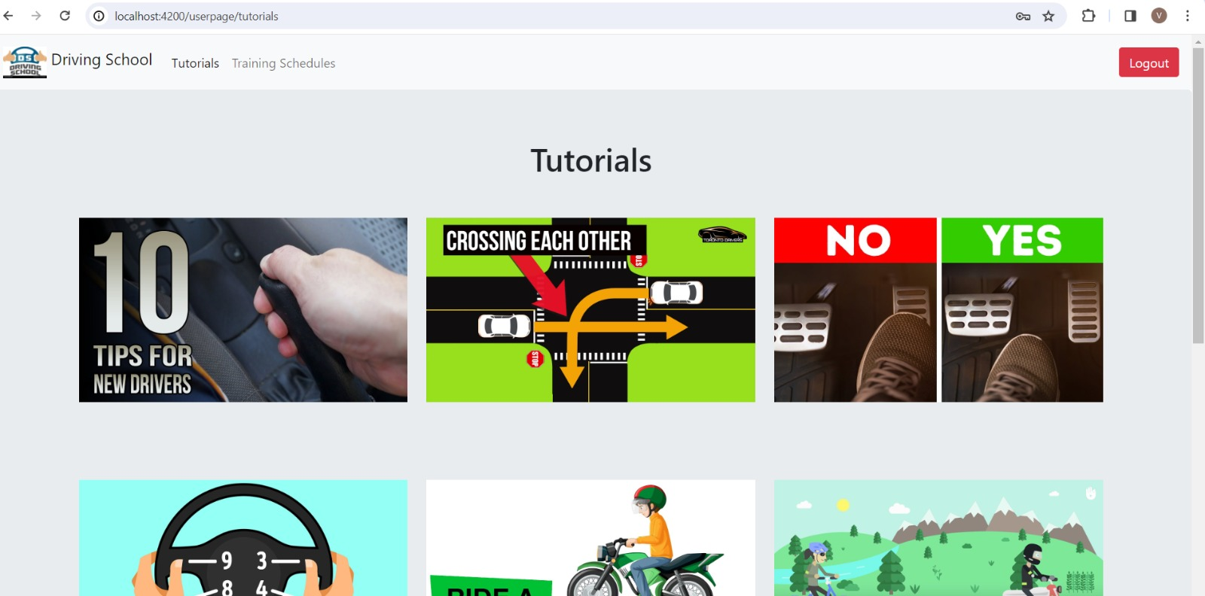

Slide 51
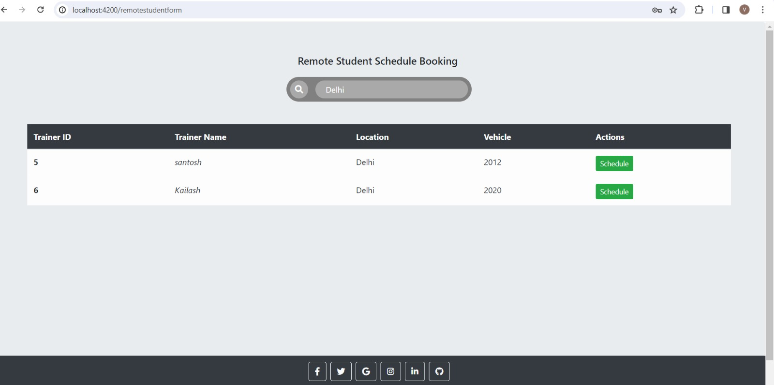

Slide 53
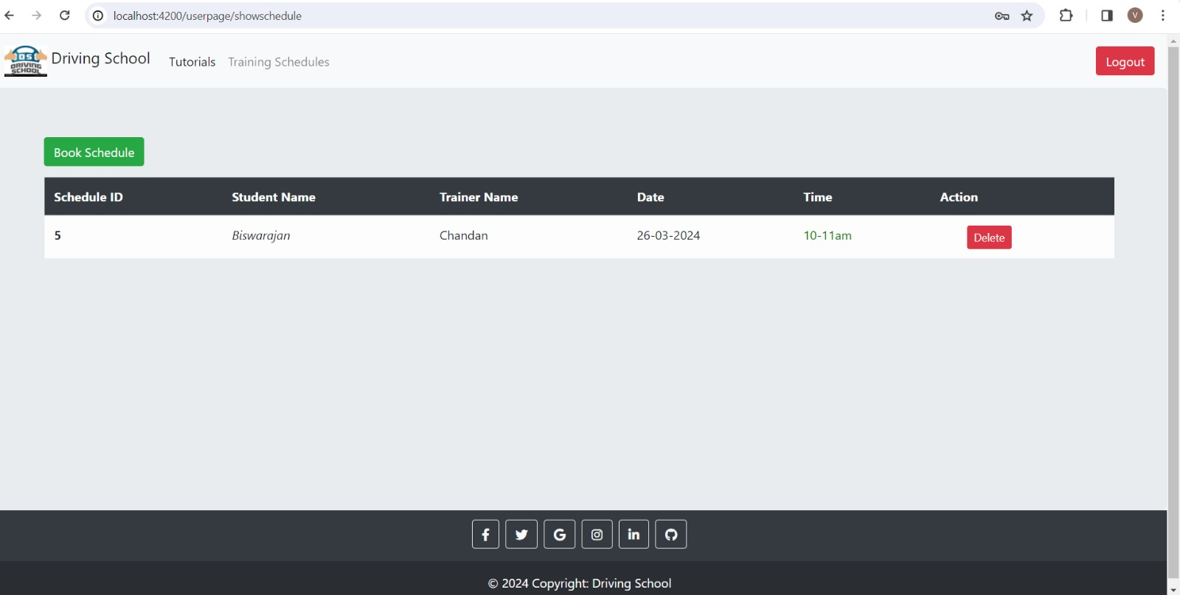

Slide 55
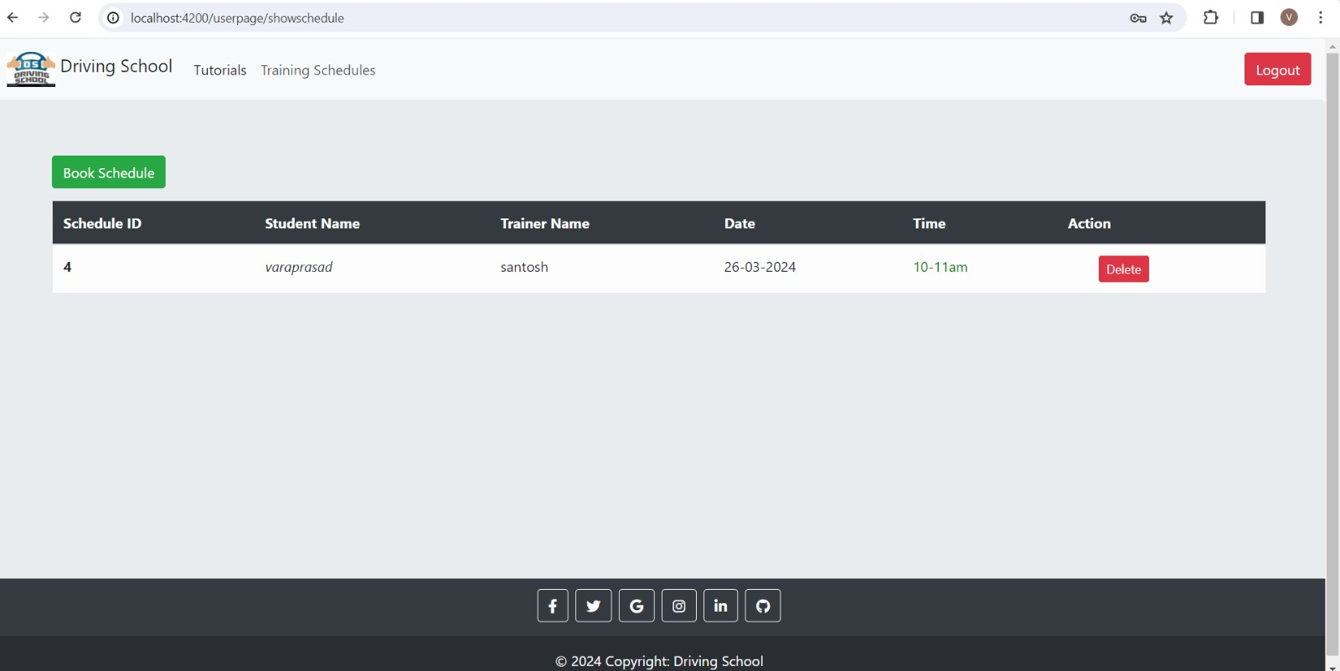

Slide 56
CONCLUSION
This Advanced Motor Driving School Management system is web-based application for maintaining records of driving school.
This application automates manual tasks by managing all records of student’s admission, Attendance, vehicles ,and trainer.
.

Slide 57


